Slide 1

Inclusive Pedagogy
University of Richmond
School of Law
Adjunct Training
August 11, 2021

Slide 2

Classroom Climate

Slide 3

power dynamics in the classroom
the classroom is a space in which power is not only exercised but experienced in multiple ways
consider how your own social identities are relevant to the power dynamics at play
critically examine your ideas, assumptions, and values, and how those beliefs have an impact on your classroom teaching
allow students leadership roles during class sessions and give them opportunities to share their expertise (or at least experience)
share responsibility with students for taking on other perspectives and for sustaining a productive learning community
engage students in creating classroom norms reflective of diversity, and revisit norms regularly
tell students you are working on being as inclusive as possible and ask that they help build a positive and productive classroom climate
solicit feedback at various points during the semester and ask students if your classroom, your teaching, and your course seem inclusive.

Slide 4

student engagement
think about how you solicit participation and how to ensure that all students participate
create opportunities for students to interact with each other during the semester
offer multiple, diverse, and active ways to know, engage, and contribute
structure discussions to include a range of voices: take a queue, ask to hear from those who have not spoken, wait until several hands are raised to call on anyone, use think-pair-share activities
take time to learn about your students’ prior knowledge and use it to foster engagement; maybe distribute a questionnaire early in the term to learn about students’ experience with the course topics, educational background, professional ambitions, general interests.
establish ways for students to intervene if they feel a certain perspective is being undervalued or not acknowledged
stop or intervene in a discussion if comments become disparaging or devalue other students’ experiences

Slide 5

Course Content

Slide 6

include a range of sources and voices
be transparent on content choices and course design; be explicit about organization and narrative of the course by naming and discussing the agenda(s) and historical biases of your field/department
to the extent possible, include a wide range of perspectives, experiences, and backgrounds in your course materials—and be attentive to the costs of materials
choose readings that deliberately reflect the diversity of contributors to the field and emphasize the range of identities and backgrounds of experts who have contributed to a given field
use visuals that do not reinforce stereotypes but do include a diversity of people, families, institutions, or perspectives
use diverse and inclusive examples to illustrate concepts, drawing upon a range of domains of information; similarly, use varied names and socio-cultural contexts in test questions, assignments, and case studies.
avoid references that are likely to be unfamiliar to some students based on their backgrounds

Slide 7

Student Assessment

Slide 8
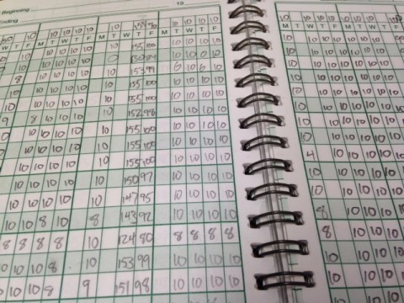
practice clarity and use variety
provide clear expectations and grading criteria (in writing) for the course and all assignments: show the the alignment of course objectives to the assessments
be explicit about your assessment criteria and how they relate to learning goals, and share successful examples
think beyond tests and papers; give students multiple ways and repeated opportunities to reflect upon and demonstrate their learning and growth
create opportunities for students to make their learning visible to the full learning community to help build solidarity as opposed to competition around assessment
create low-stakes opportunities for students to practice before they are asked to perform

